Slide 1
FOR ATTENDEES
Please watch in Slideshow mode to benefit from the animation.
The Slide used “OpenSans” and “Roboto” font. If you don’t have it, please use google slides for viewing.
Feel free to email me feedbacks if any ☺

Slide 2

A Field Guide To TensorFlow Contribution
Srishti Yadav
Google Developers Group, Vancouver
December 04, 2019

Slide 3
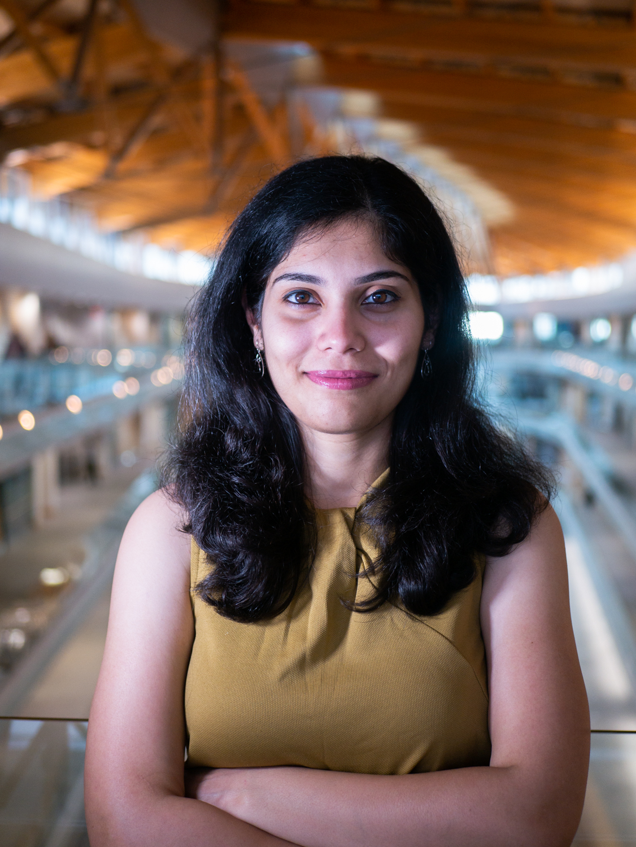






ABOUT ME
Graduate Researcher at Simon Fraser University
Develops computer vision algorithm for low power processing units
Comes from a background in Electronics Engineering, later switched to Computer Science
Organizer of Women in Machine Learning workshop (NeurIPS’19).
Organizer of Women in Computer Vision workshop (CVPR’20)
Organizer of developer community meetups in Vancouver.
Belief: Open Source used in research (read ‘academia’) should be reproducible.
@_srishtiyadav
srishti-yadav

Slide 4
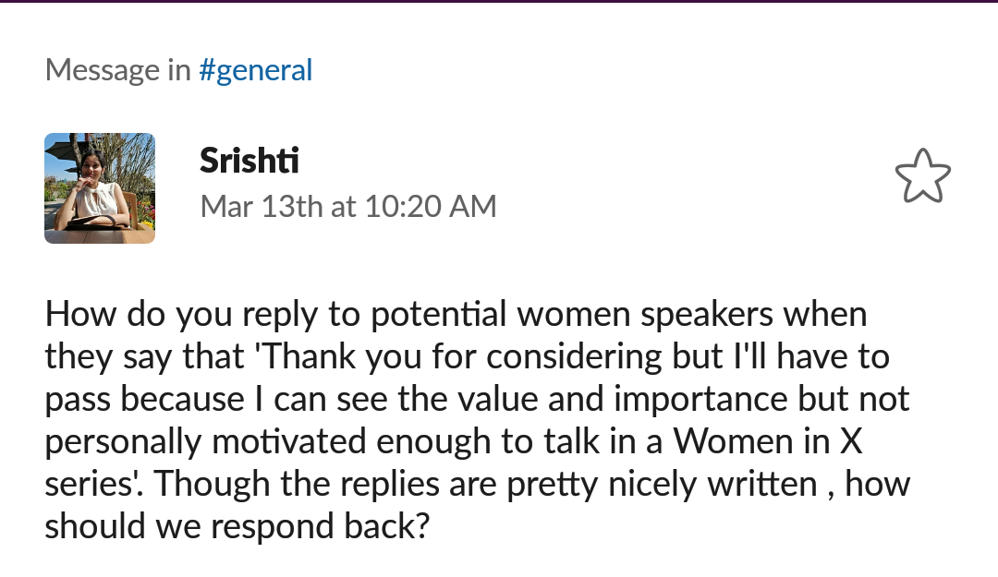
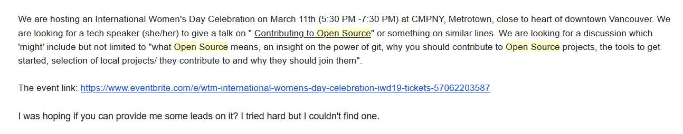
MY STORY: HOW I ENTERED OPEN SOURCE?
Here X was Open Source
@_srishtiyadav
srishti-yadav

Slide 5
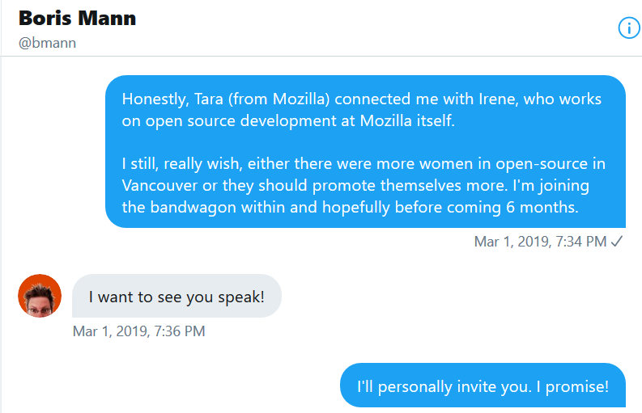
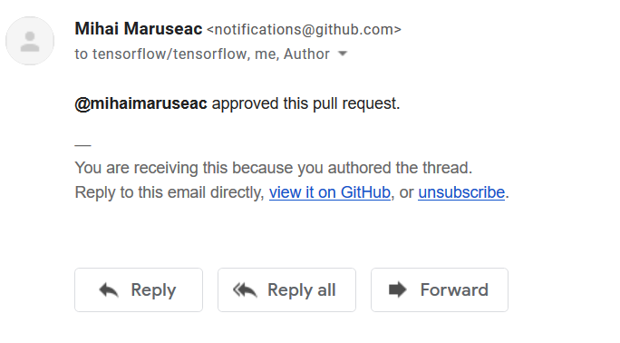
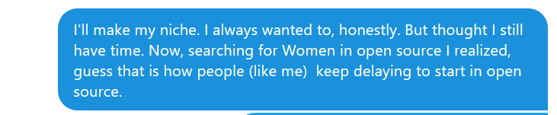
MY STORY: HOW I ENTERED OPEN SOURCE?
And one day..
“ I really wish, either there were more women in open source in Vancouver or thy should promote themselves more.”
@_srishtiyadav
srishti-yadav

Slide 6







BUT WHY TENSORFLOW ?
Because I work with it and hence comfortable with the language.
Reason for choice can be simple!
@_srishtiyadav
srishti-yadav

Slide 7
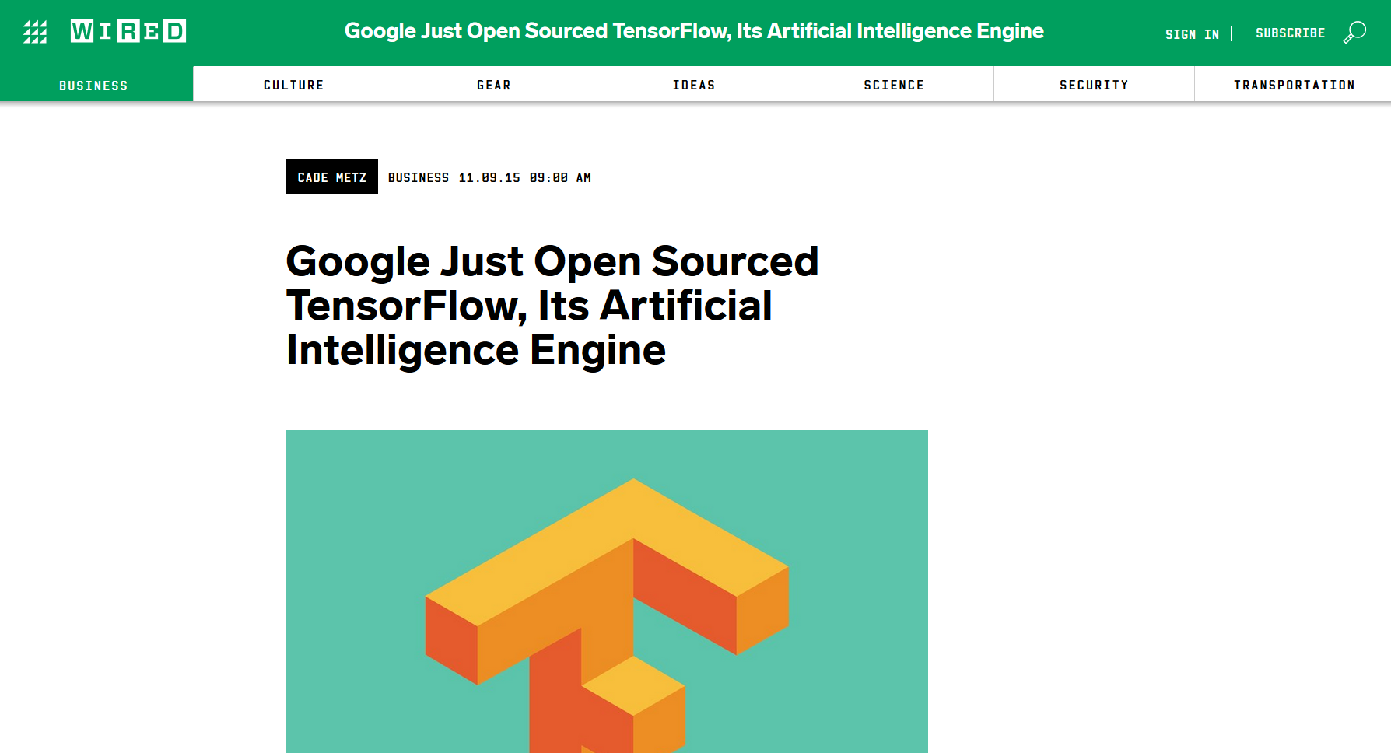
TENSORFLOW: IT ALL STARTED IN LATE 2015
@_srishtiyadav
srishti-yadav

Slide 8
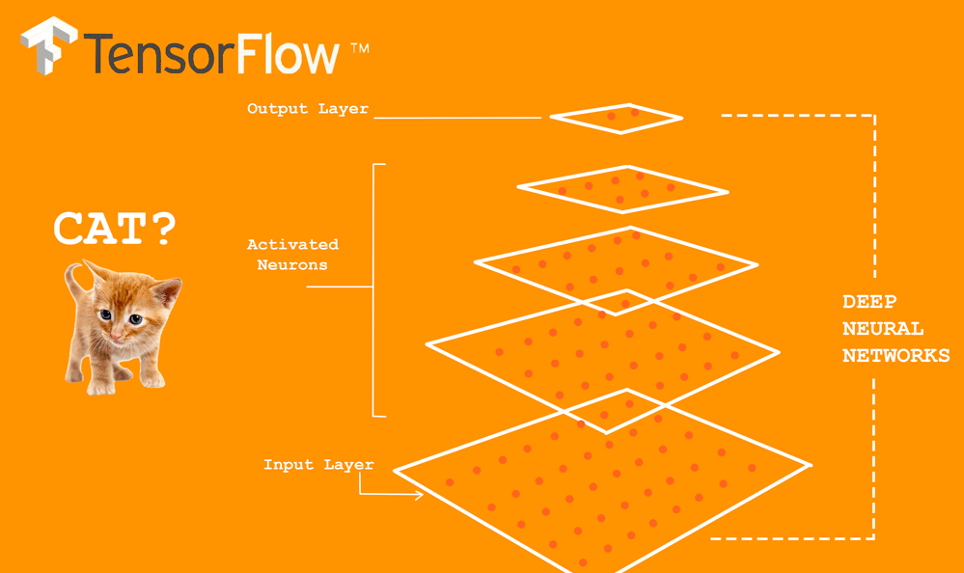

WHAT IS TENSORFLOW AND HOW IT WORKS? https://www.tensorflow.org/
TF is an open-source library for numerical computation and large scale machine learning
provides a convenient front-end API for building applications
executes those applications in high-performance
Credits: Soygema,
GoogleAI
@_srishtiyadav
srishti-yadav

Slide 9
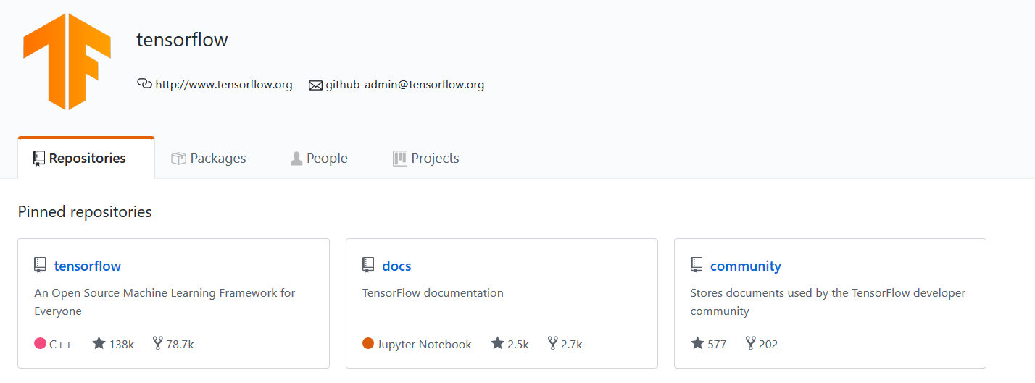
WHERE TO START ? The easiest part: https://github.com/tensorflow
@_srishtiyadav
srishti-yadav

Slide 10
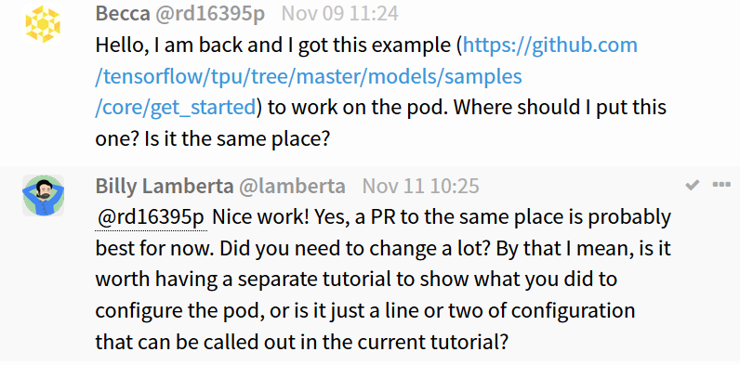
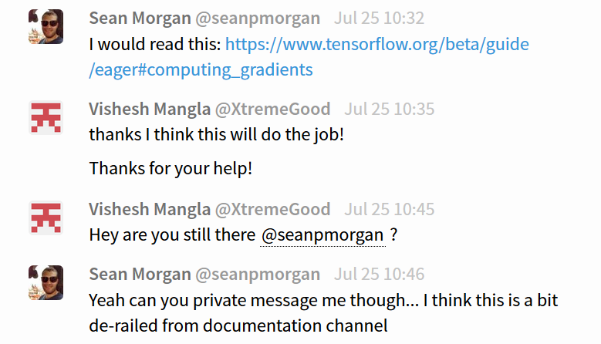
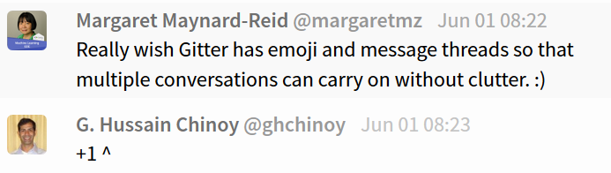
Gitter Chat Room
Rooms: https://gitter.im/tensorflow/ ; Docs is a good place to start
Good place to ask smaller questions and interesting conversations:
Perfect place to develop relations with other contributors and the maintainers
@_srishtiyadav
srishti-yadav

Slide 11
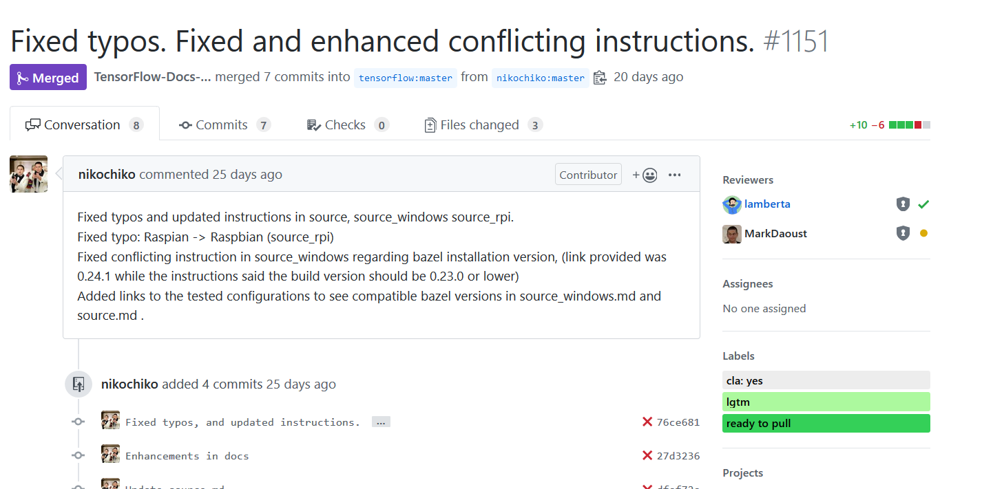
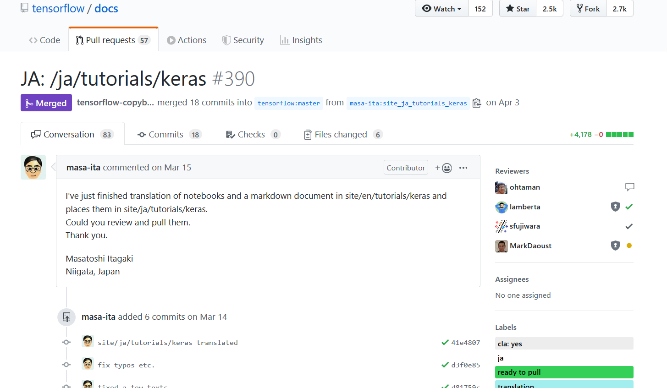
LET’S CHECKOUT SOME OF THE CONTRIBUTIONS
@_srishtiyadav
srishti-yadav

Slide 12
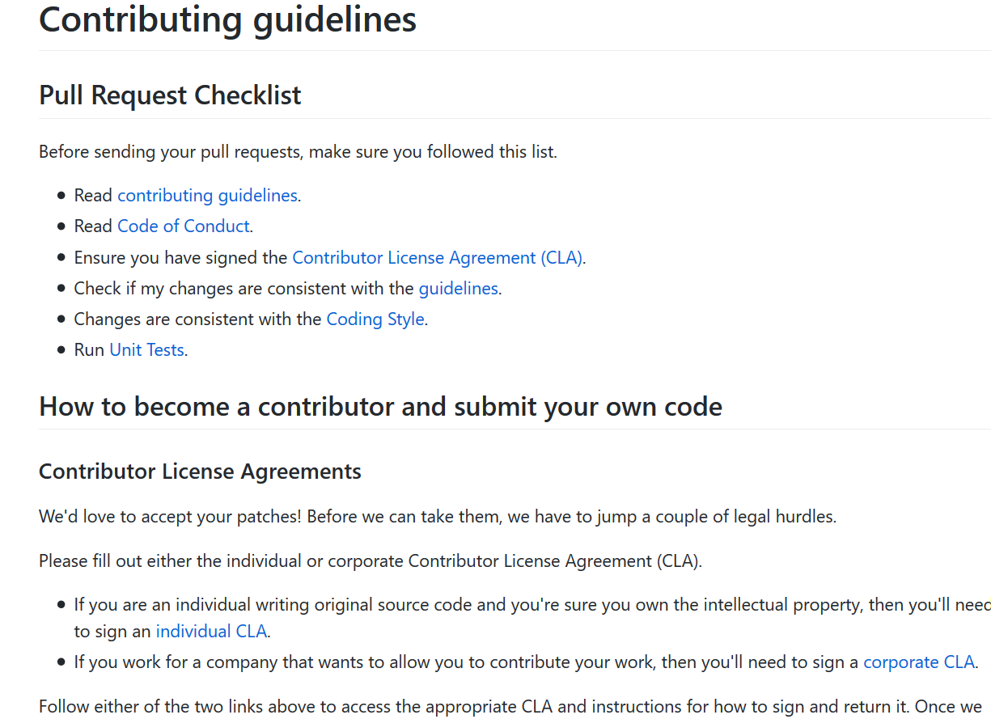
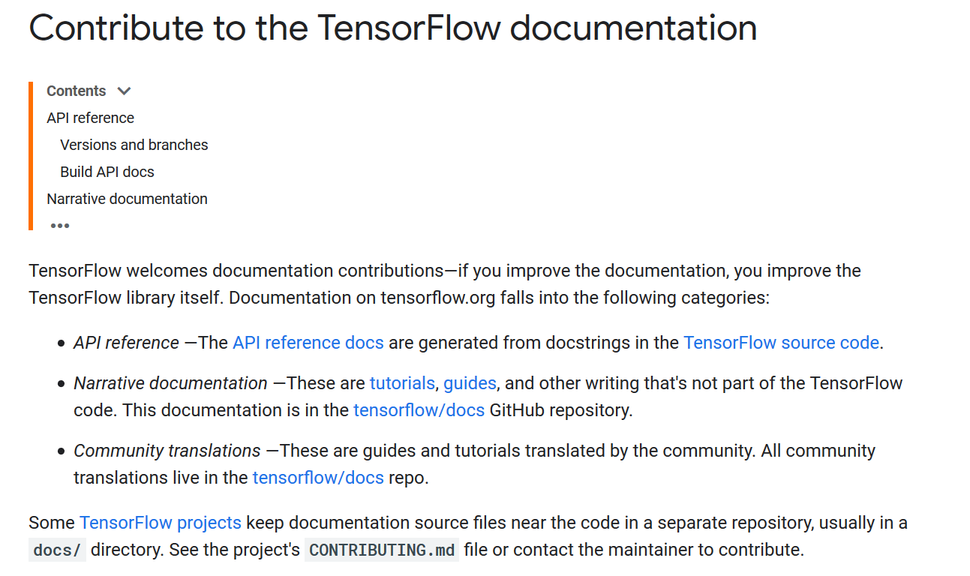
HOW TO START CONTRIBUTING? Checkout contributor guidelines
@_srishtiyadav
srishti-yadav

Slide 13
A TYPICAL WORKFLOW FOR YOUR FIRST PR
Code fixes
API symbol review
Other documentation issue
1.) Find an issue that others have raised and propose a fix
2.) Find out an issue ourselves and propose a fix
Forking the repo
Clone the forked repo on your local system
Locate the file which needs fixing in your forked repo
Create a new branch
File a Pull Request
Save + Commit + Push to your repo
Edit the file using your favorite text editor
@_srishtiyadav
srishti-yadav

Slide 14
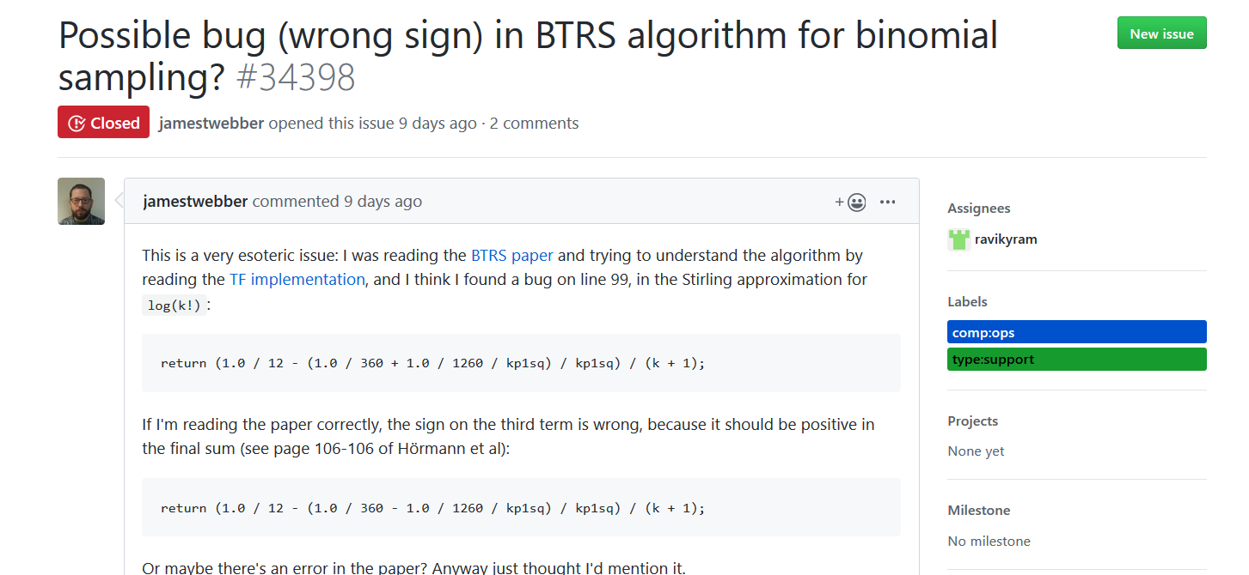
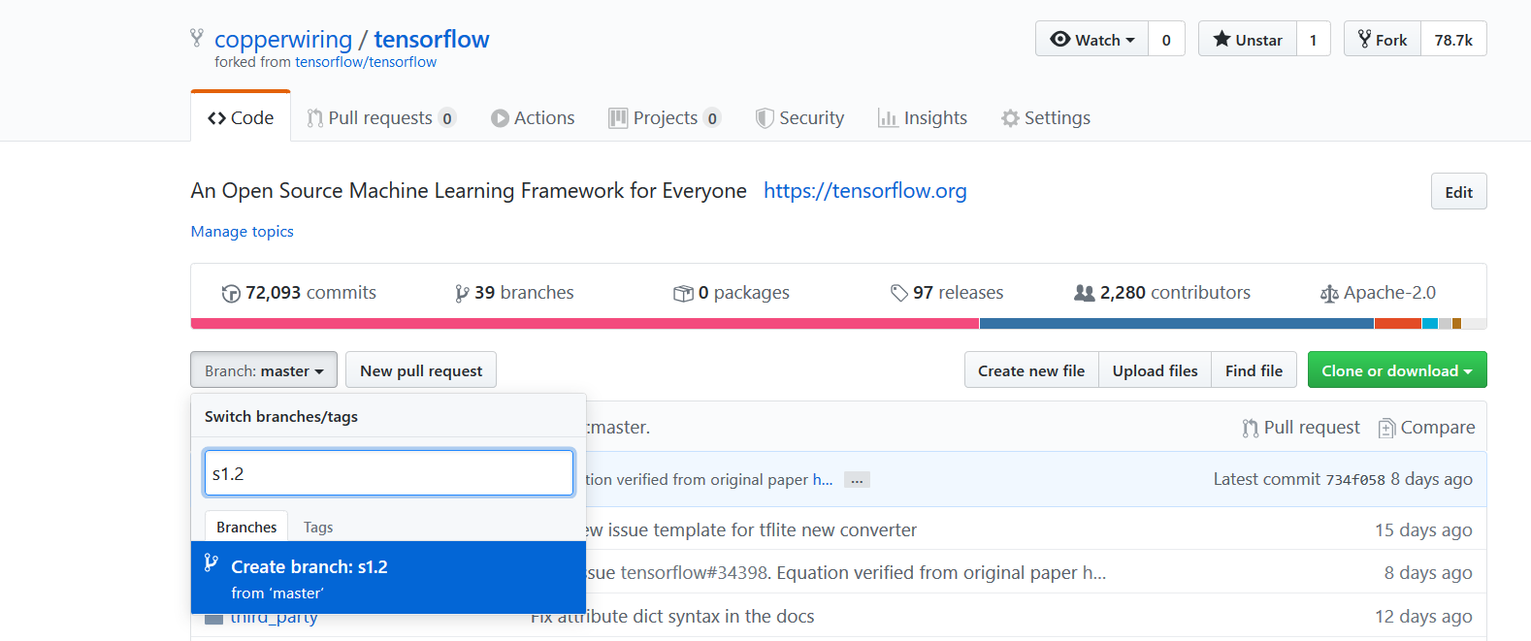
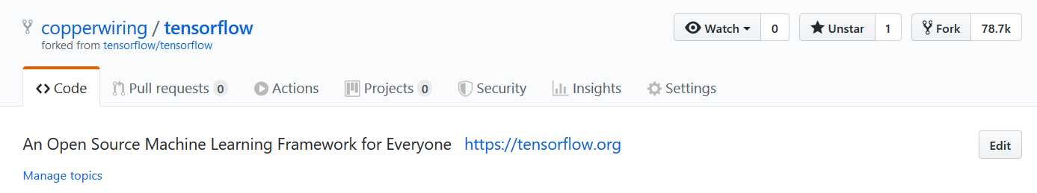
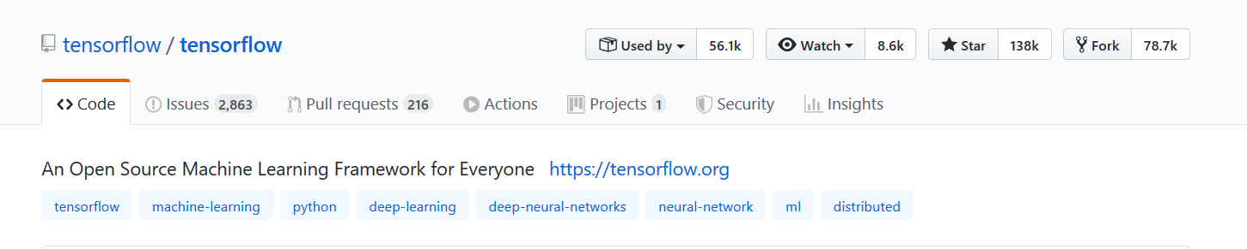
1.) Find an issue that others have raised and propose a fix
2.) Find out an issue ourselves and propose a fix
Forking the repo in your repository
Create a new branch
@_srishtiyadav
14
srishti-yadav

Slide 15
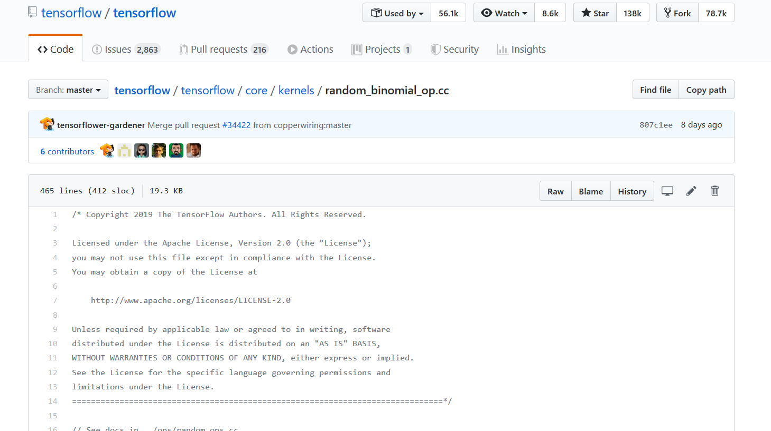
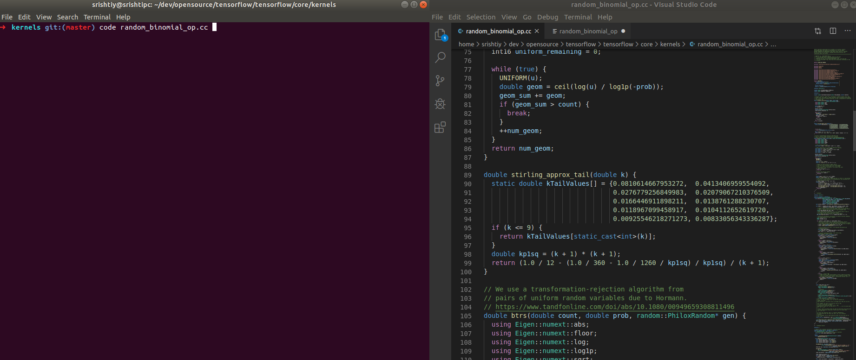
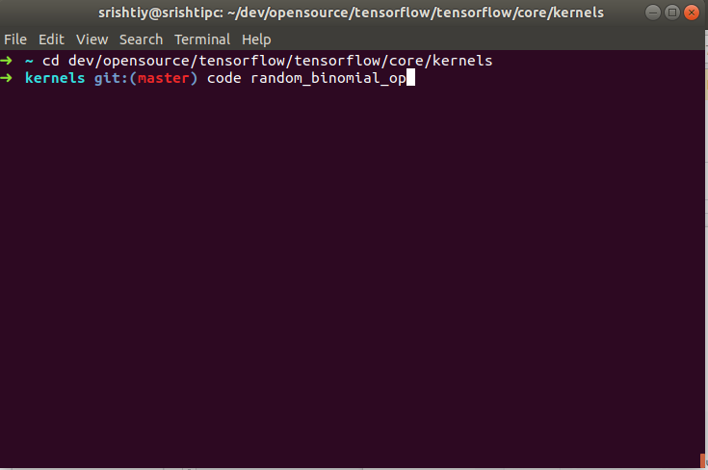
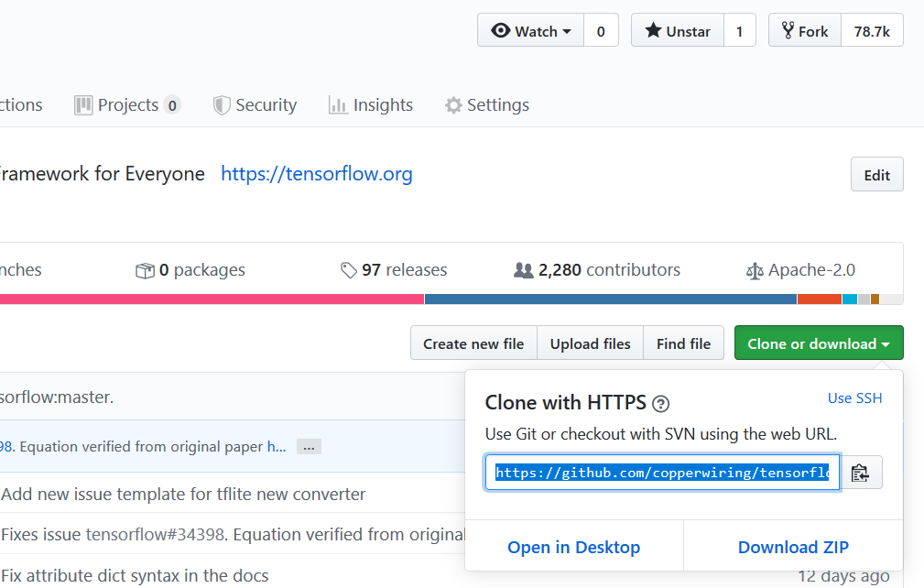
1.) Find an issue that others have raised and propose a fix
2.) Find out an issue ourselves and propose a fix
Forking the repo in your repository
Clone the repo on your local system
Locating the file which needs fixing in your forked repo
Editing the file using your favorite text editor
Save + Commit + Push to your repo
Create a new branch
Open terminal.
git clone <url which you just copied>
git commit -a -m <reasonable commit message>
git push
@_srishtiyadav
srishti-yadav

Slide 16
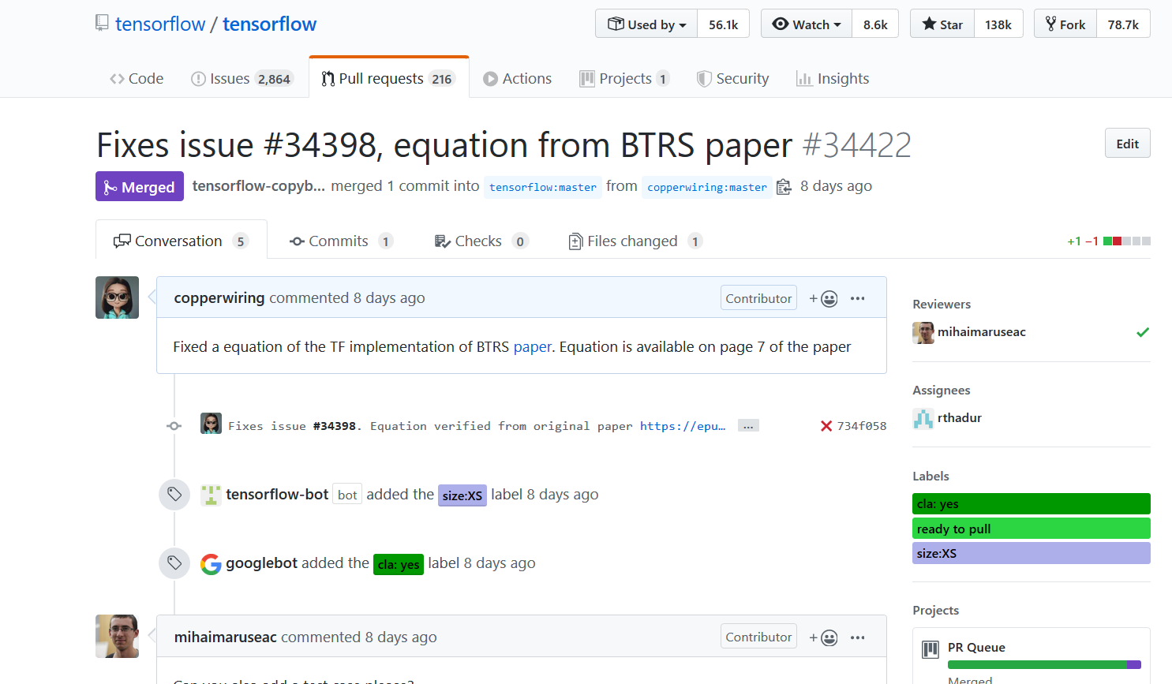
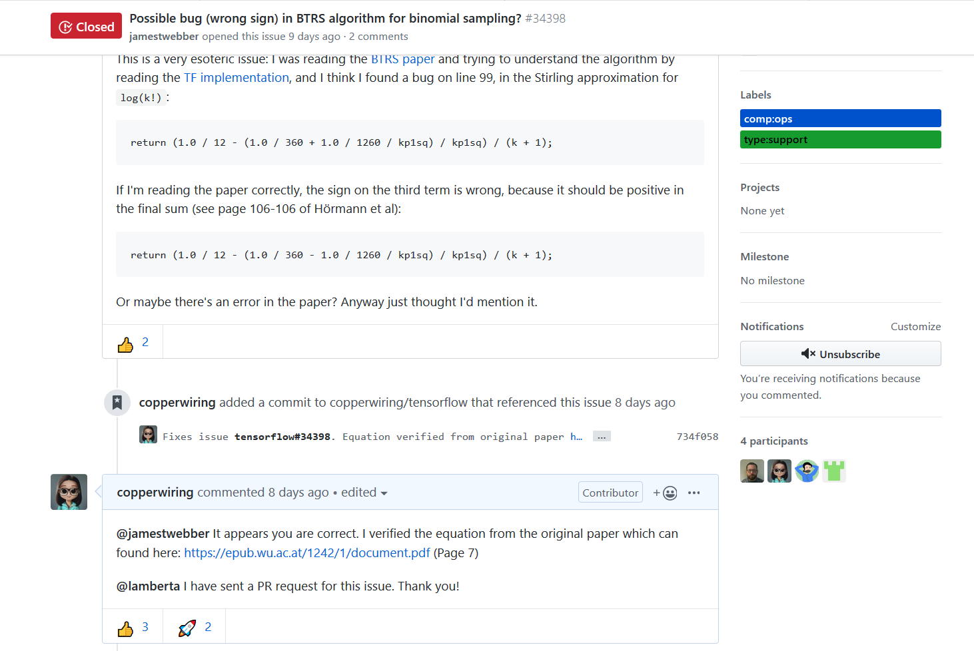
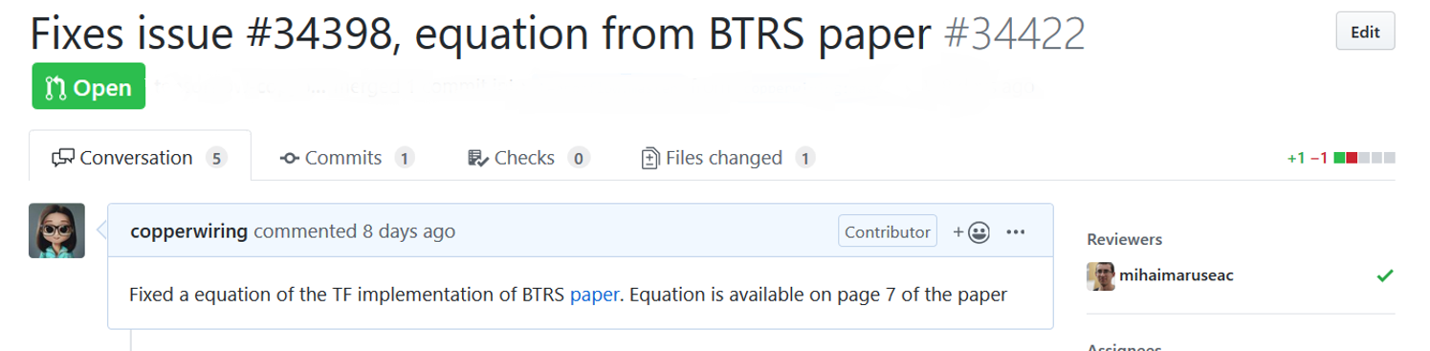
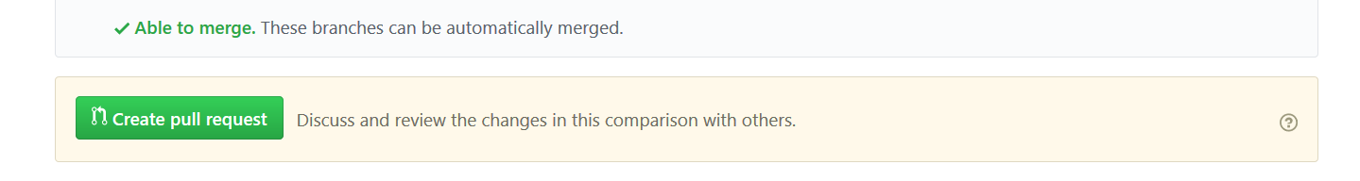
1.) Find an issue that others have raised and propose a fix
2.) Find out an issue ourselves and propose a fix
Forking the repo in your repository
Clone the repo on your local system
Locating the file which needs fixing in your forked repo
Editing the file using your favorite text editor
Save + Commit + Push to your repo
File a Pull Request
Create a new branch
@_srishtiyadav
srishti-yadav

Slide 17
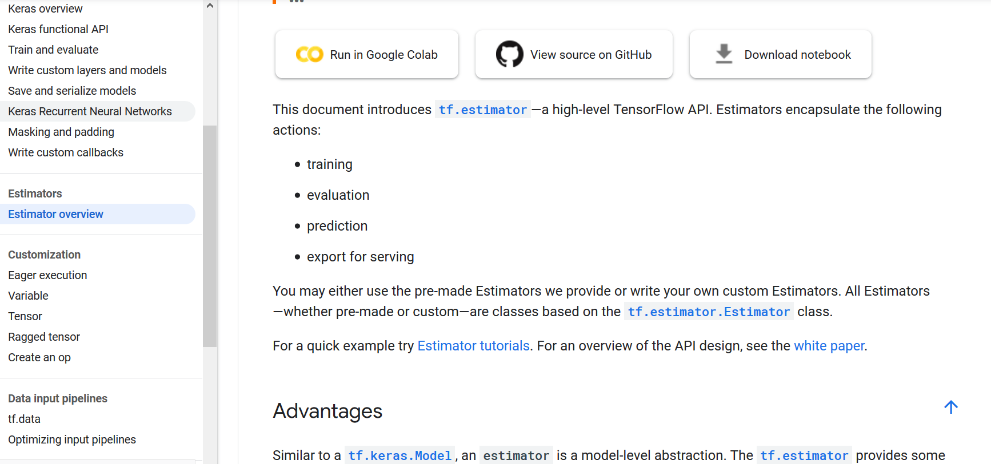
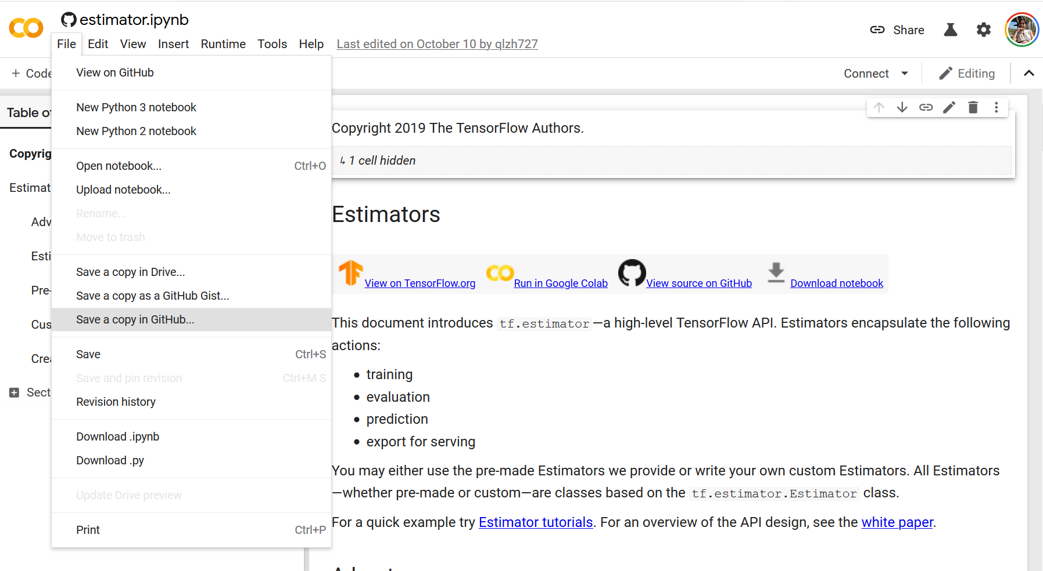
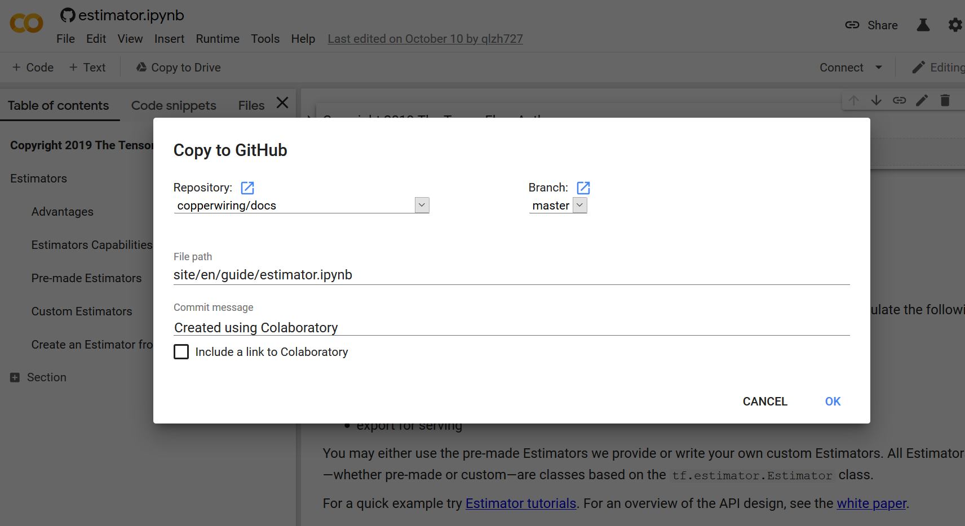
BONUS : YOU CAN ALSO EDIT IN COLAB

Slide 18
YOUR FIRST CONTRIBUTION NEED NOT BE A PULL REQUEST
You can raise an issue . Someone may benefit from your issue.
Support others answers by upvoting them. Gives more visibility to better answers.
Post links to relevant forums/discussions which may help an existing issue.
@_srishtiyadav
srishti-yadav

Slide 19
TENSORFLOW 2.0
@_srishtiyadav
srishti-yadav

Slide 20
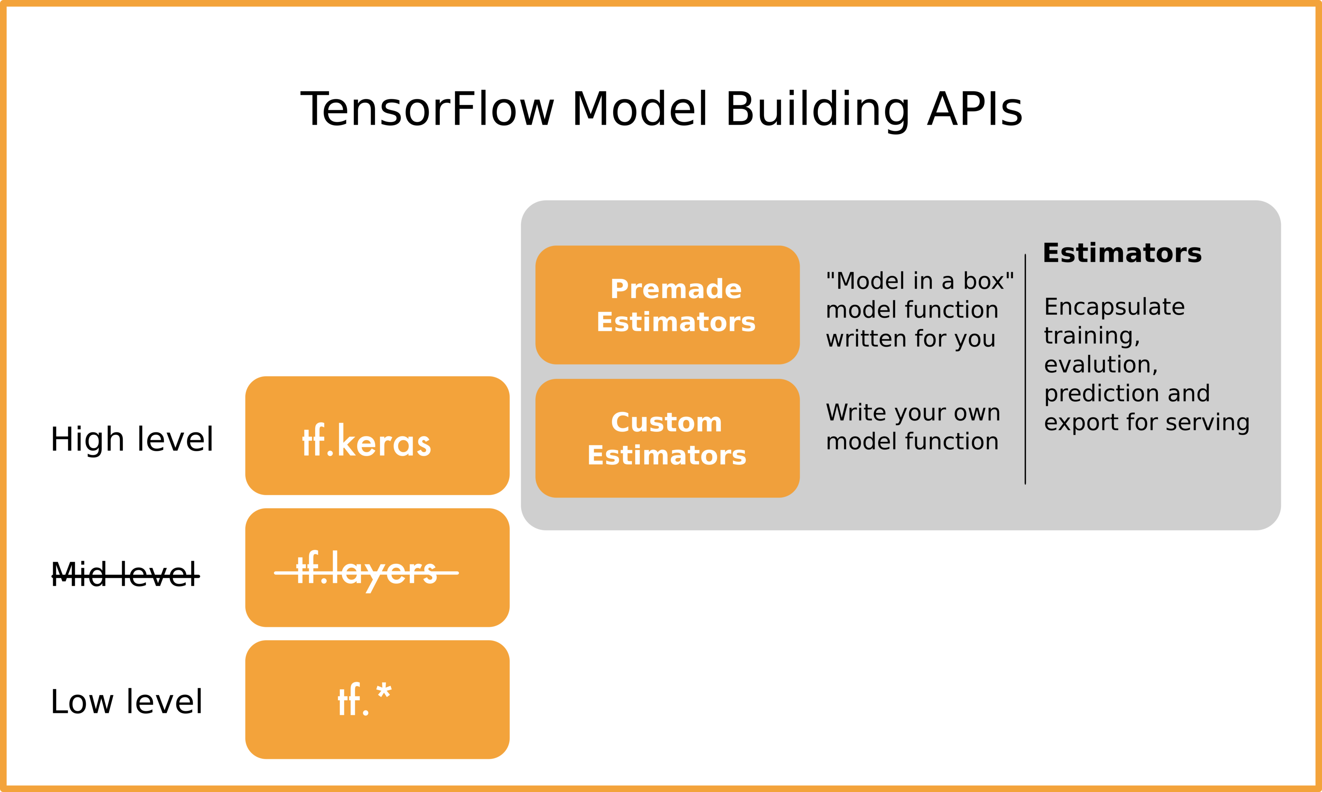
TENSORFLOW MODEL BUILDING API
@_srishtiyadav
srishti-yadav
Notes:
This slide is hidden.
Will only be shown during Q&A if necesary

Slide 21
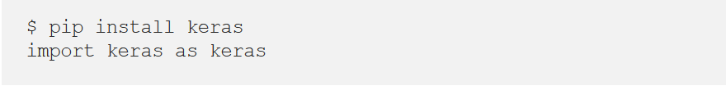
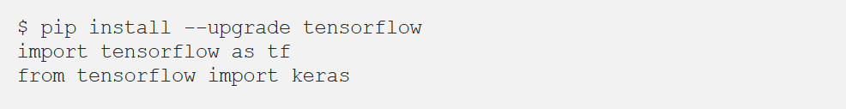
WHAT’S NEW IN TENSORFLOW 2.0 1.) Keras is integrated as a part of core TF API. It is recommended high level API
We no more need to write:
We can simply write:
@_srishtiyadav
srishti-yadav

Slide 22
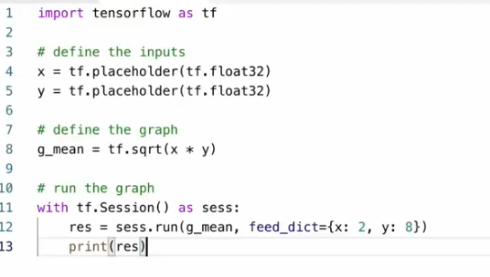
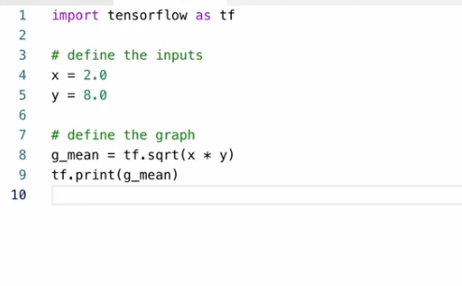
WHAT’S NEW IN TENSORFLOW 2.0 2.) We no longer need Session()
@_srishtiyadav
srishti-yadav

Slide 23
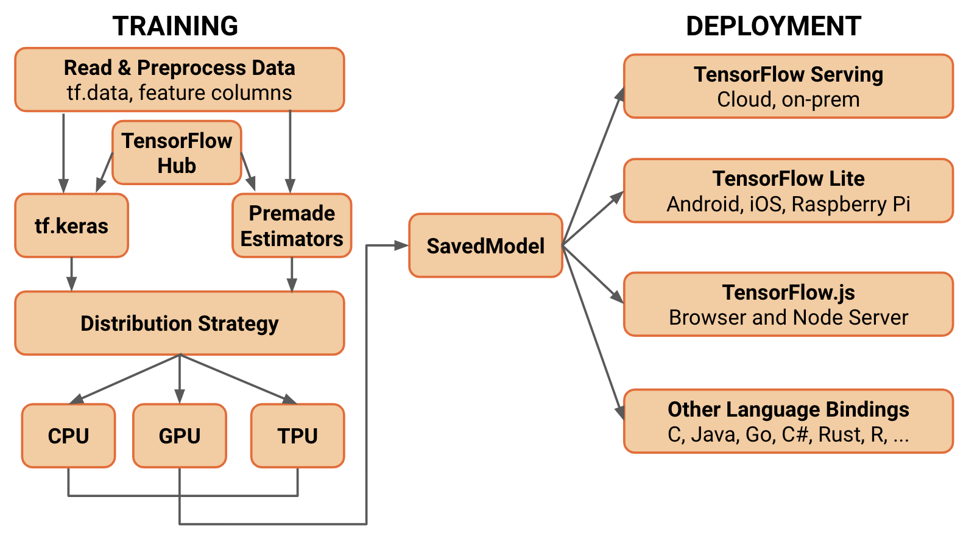
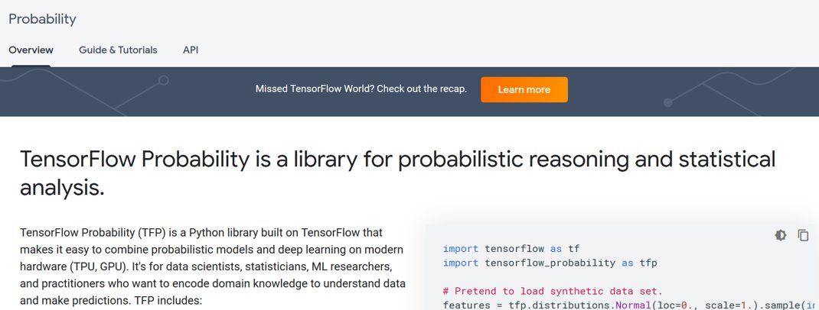
WHAT’S NEW IN TENSORFLOW 2.0 3.) Ecosystem
TF is more than just TF Core i.e. there are a lot of parts to the ecosystem now
Compatibility throughout TensorFlow ecosystem:
For instance, previously we had multiple ways to save models
Now it is standardized to something called `saved_models`.
@_srishtiyadav
srishti-yadav

Slide 24
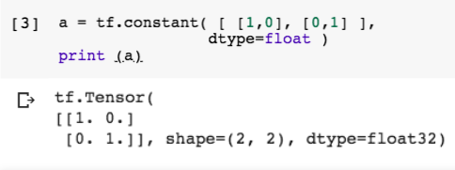

WHAT’S NEW IN TENSORFLOW 2.0 4.) Duplication & Faster Debugging
Eager executions are now default
In 2.0 is gone so other projects are more independent but still part of the ecosystem
@_srishtiyadav
srishti-yadav

Slide 25
OPEN SOURCE IS ALL ABOUT COMMUNTY
It improves a solution that community as a whole can benefit from (and believe in)
Open source code means you get full visibility of the code base.
Open source software's code is often more secure because it's thoroughly reviewed and vetted by the community
@_srishtiyadav
srishti-yadav

Slide 26
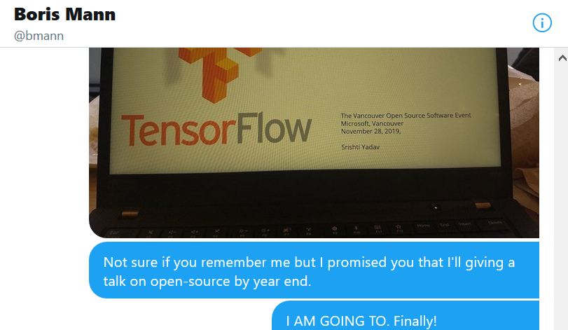
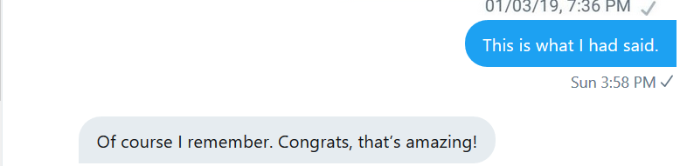
THIS WAS MY STORY
@_srishtiyadav
srishti-yadav

Slide 27
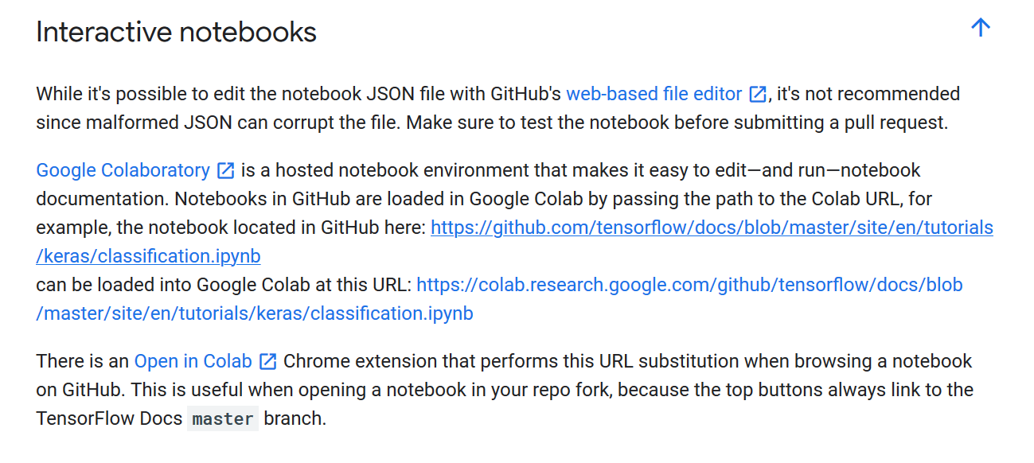
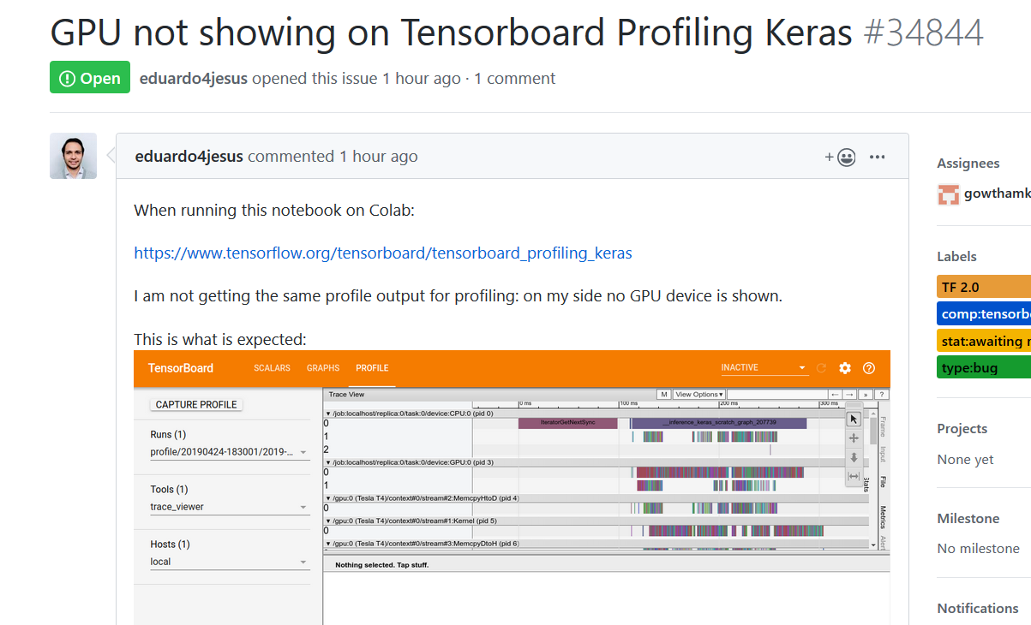
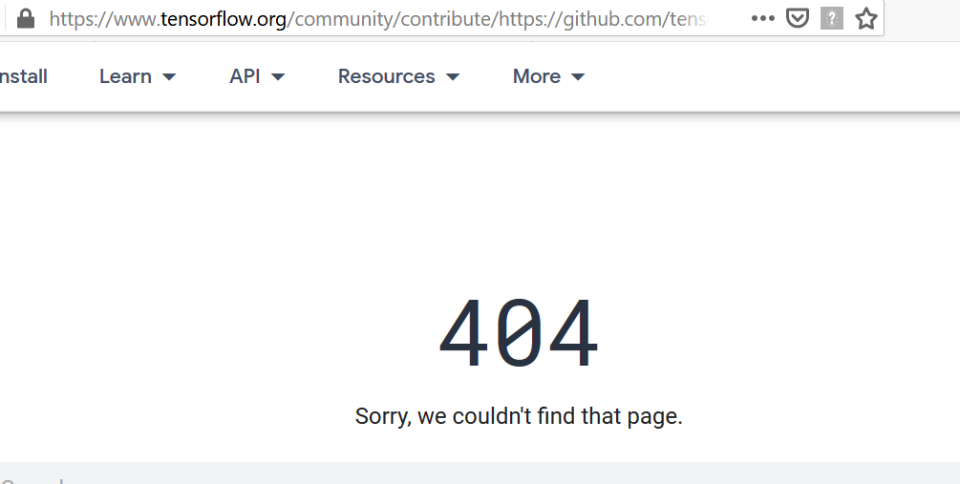
YOUR FIRST CONTRIBUTION ?
Beginner:
https://www.tensorflow.org/community/contribute/docs
Advance:
https://github.com/tensorflow/tensorflow/issues/34844
@_srishtiyadav
srishti-yadav

Slide 28
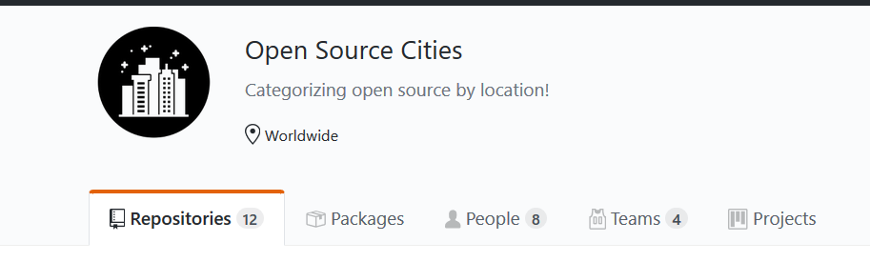
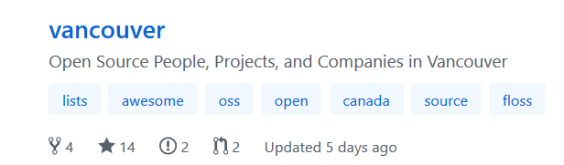
WE NEED YOUR HELP! Disclaimer: It’s not a personal project. It’s a community initiative from Vancouver
Do you contribute to Open Source?
Do you have an Open Source project which you’re proud of?
Are you an organization involved in open source?
We welcome Pull Request (I recently started maintaining it) to:
https://github.com/opensourcecities
@_srishtiyadav
srishti-yadav

Slide 29
THANK YOU
LinkedIn: https://www.linkedin.com/in/srishti-yadav/
Twitter: https://twitter.com/_srishtiyadav
Email: srishtiy@sfu.ca
Link for opensource cities: https://github.com/opensourcecities
@_srishtiyadav
srishti-yadav

